Slide 1

Discrete Math Chapter 3
Recursion Algorithms

Slide 2
Chapter 3 Overview
3-1 Recursion Definition
3-2 Recurrence Relations
3-3 Analysis of Algorithms

Slide 3
Notes of Chapter 3
Recursion is a common structures in computer science. Programming languages are defined in recursive definition, and compilers are written in recursive algorithms.
Recursion is also a common way to define sequence in math.
In algorithm and data structure, recursion algorithm is widely used to solve problems, such as subsequence matching, graph traversal, sorting algorithms.

Slide 4

3-1 Recursive Definitions

Slide 5
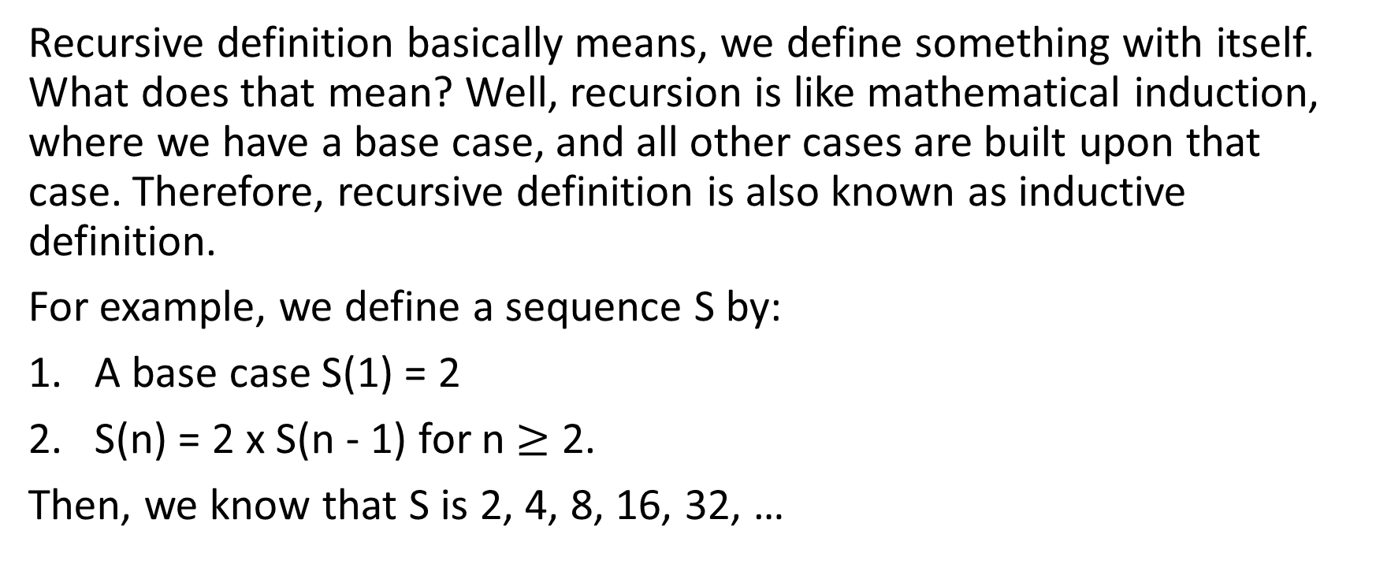
Recursive Definitions
Recursive definition basically means, we define something with itself. What does that mean? Well, recursion is like mathematical induction, where we have a base case, and all other cases are built upon that case. Therefore, recursive definition is also known as inductive definition.
For example, we define a sequence S by:
A base case S(1) = 2
S(n) = 2 x S(n - 1) for n $≥$ 2.
Then, we know that S is 2, 4, 8, 16, 32, …

Slide 6

Example 3-1-1
List the first 5 elements of the following recursive defined sequence:
$A_{1}=3, A_{n}=A_{n−1}+5$ for n $≥$ 2
$A_{1}=2, A_{n}=3A_{n−1}$ for n $≥$ 2
$A_{1}=1, A_{n}=2A_{n−1}+$7 for n $≥$ 2

Slide 7
Example 3-1-2
A recursive defined set is defined as the following:
An empty string is in this set. Also, if x is in the set, then 10x and x01 are in the set too.
Then, list 10 elements of this set.

Slide 8
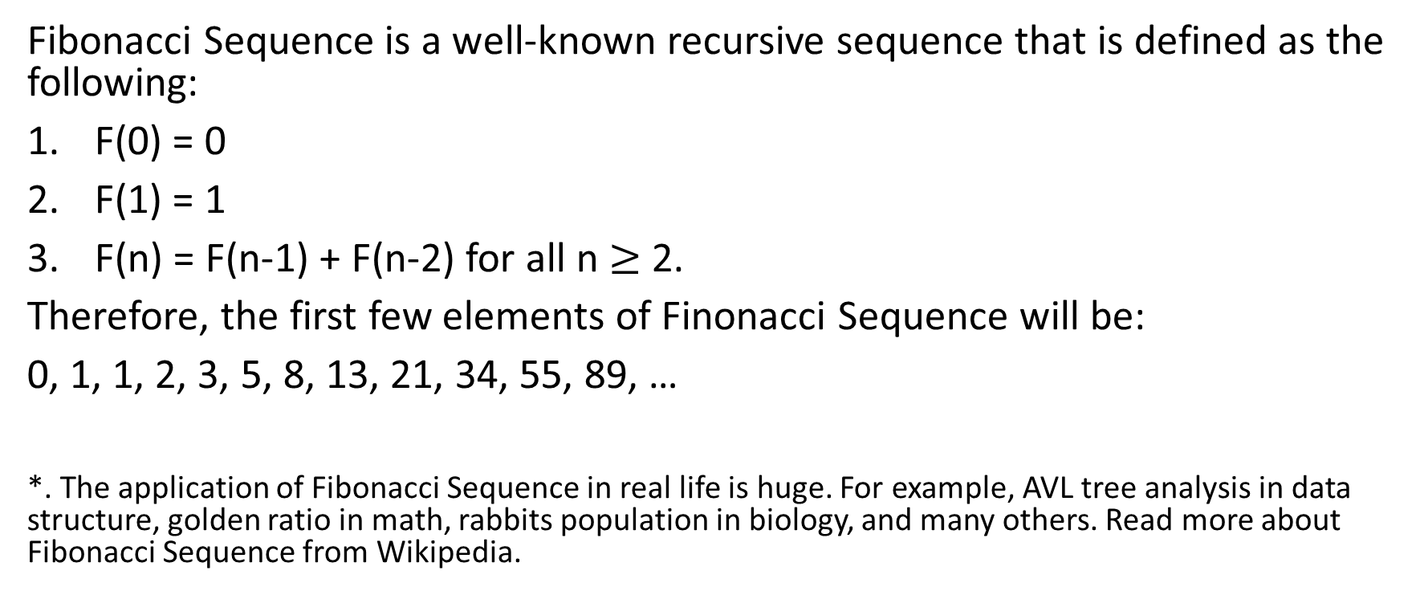
Fibonacci Sequence
Fibonacci Sequence is a well-known recursive sequence that is defined as the following:
F(0) = 0
F(1) = 1
F(n) = F(n-1) + F(n-2) for all n $≥$ 2.
Therefore, the first few elements of Finonacci Sequence will be:
0, 1, 1, 2, 3, 5, 8, 13, 21, 34, 55, 89, …
*. The application of Fibonacci Sequence in real life is huge. For example, AVL tree analysis in data structure, golden ratio in math, rabbits population in biology, and many others. Read more about Fibonacci Sequence from Wikipedia.

Slide 9
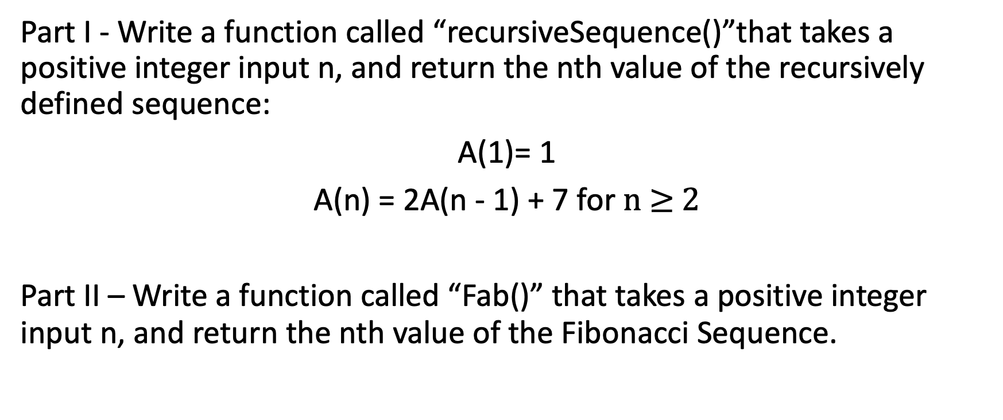
Coding Lesson
Part I - Write a function called “recursiveSequence()”that takes a positive integer input n, and return the nth value of the recursively defined sequence:
A(1)= 1
A(n) = 2A(n - 1) + 7 for n $≥$ 2
Part II – Write a function called “Fab()” that takes a positive integer input n, and return the nth value of the Fibonacci Sequence.

Slide 10
Hanoi Tower
The Tower of Hanoi is a mathematical game or puzzle consisting of three rods and a number of disks of different diameters, which can slide onto any rod. The puzzle begins with the disks stacked on one rod in order of decreasing size, the smallest at the top. The objective of the puzzle is to move the entire stack to the last rod, obeying the following rules:
Only one disk may be moved at a time.
Each move consists of taking the upper disk from one of the stacks and placing it on top of another stack or on an empty rod.
No disk may be placed on top of a disk that is smaller than it.

Slide 11
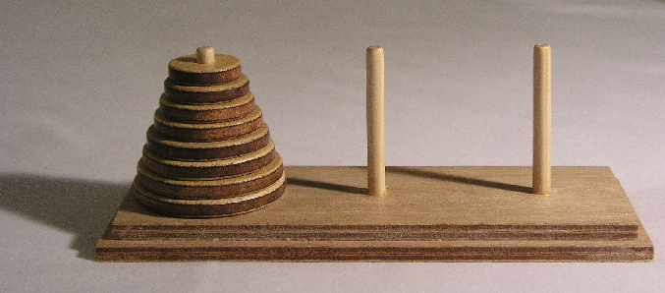
Hanoi Tower
The puzzle was invented by the French mathematician Édouard Lucas in 1883. Numerous legends popped up immediately, including one about an Indian temple in Kashi Vishwanath containing a large room with three time-worn posts in it, surrounded by 64 golden disks. Legends has it that by the day they move all 64 golden disks from one rod to another rod, that day is the end of the world.

Slide 12
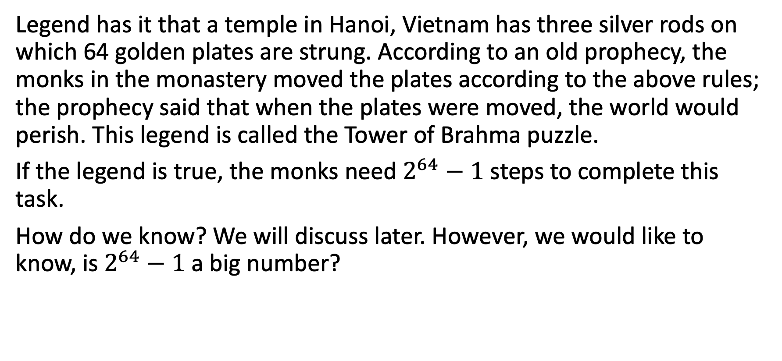
Conclusion
Legend has it that a temple in Hanoi, Vietnam has three silver rods on which 64 golden plates are strung. According to an old prophecy, the monks in the monastery moved the plates according to the above rules; the prophecy said that when the plates were moved, the world would perish. This legend is called the Tower of Brahma puzzle.
If the legend is true, the monks need $2^{64}−1$ steps to complete this task.
How do we know? We will discuss later. However, we would like to know, is $2^{64}−1$ a big number?

Slide 13
Conclusion
If they can complete one plate movement per second, it would take 584.9 billion years to complete. The entire universe is now only 13.7 billion years old; therefore, it’s impossible to achieve this.
There are several variants of this legend and there are different opinions on the location of the temple, one of which is that it is located in Hanoi, Vietnam, so it was named "Hanoi Tower". In addition, there are background settings such as "Golden disks were made when the world was created" and "Monks move a disk every day".
(The above content is taken from Wikipedia)

Slide 14
Coding Lesson
Write a function called “Hanoi()”, which takes 4 inputs. The first input is the length of an array of integers, the second input is an array of integers, and the third and fourth input are an empty array.
This function should follow the rules of Honei tower, and move all elments in the first array to the third array.

Slide 15
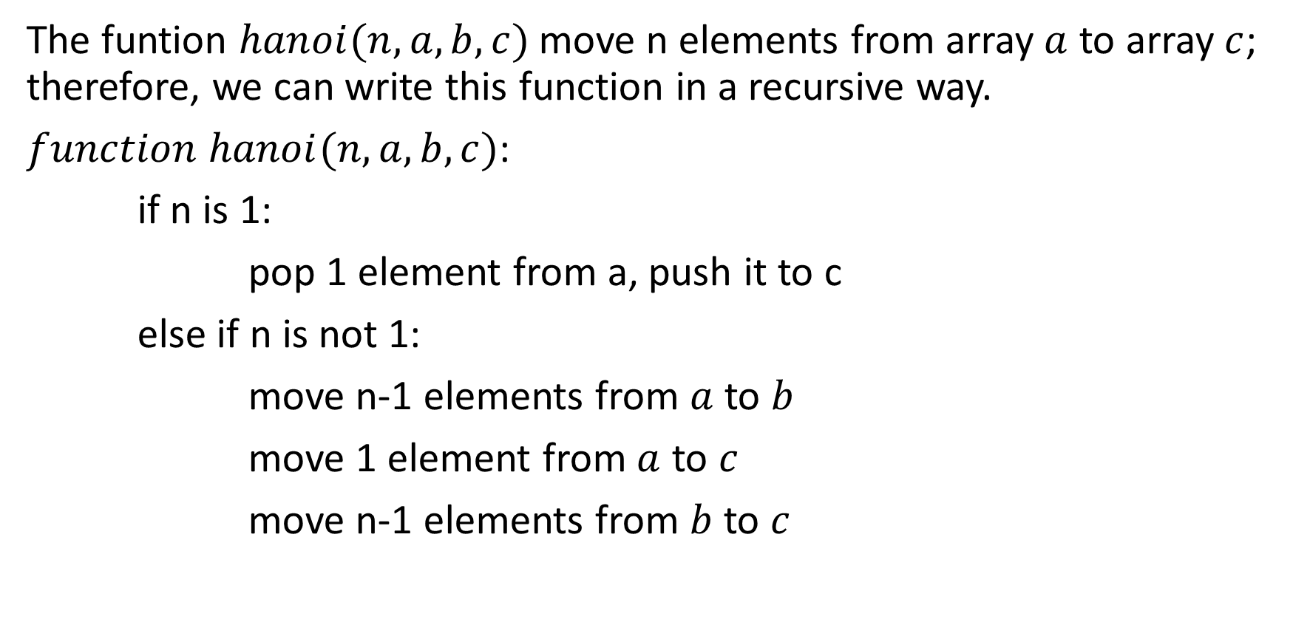
Pseudocode of Hanoi Tower Problem
The funtion $hanoi(n, a, b, c)$move n elements from array $a$ to array $c$; therefore, we can write this function in a recursive way.
$function hanoi(n, a, b, c)$:
if n is 1:
pop 1 element from a, push it to c
else if n is not 1:
move n-1 elements from $a$ to $b$
move 1 element from $a$ to $c$
move n-1 elements from $b$ to $c$

Slide 16

3-2 Recurrence Relations

Slide 17
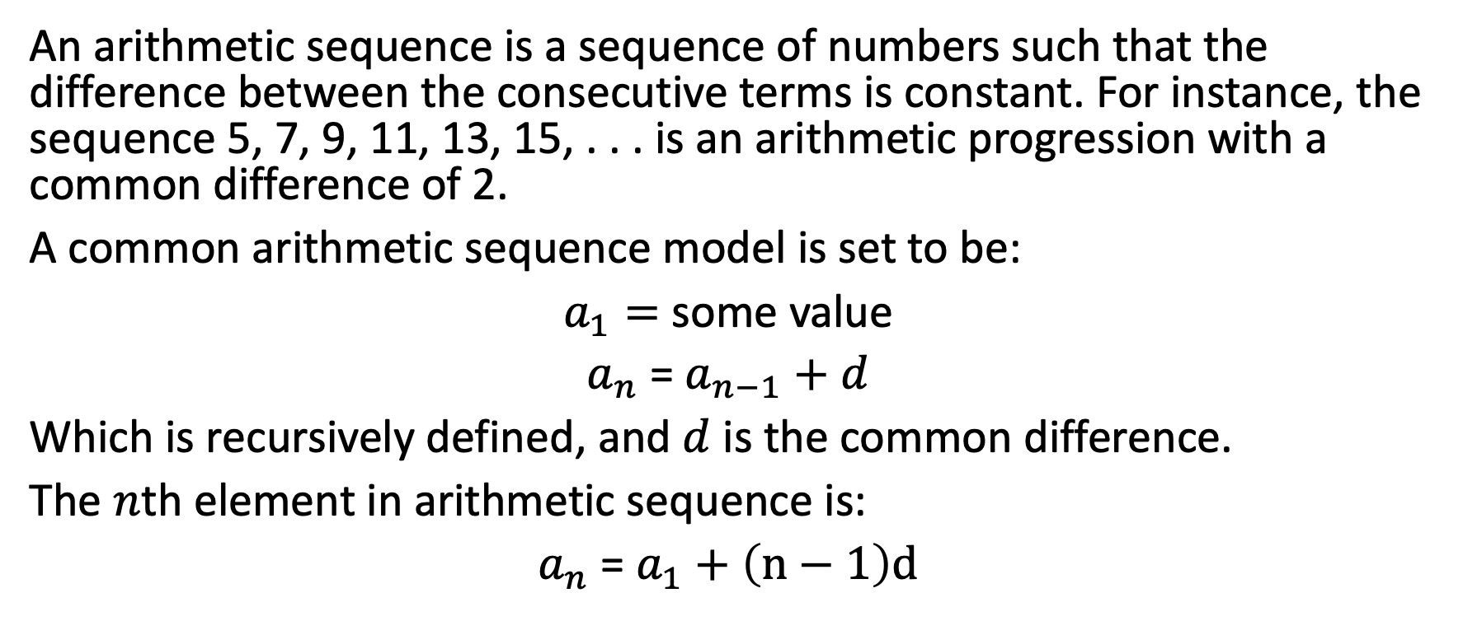
Arithmetic Sequence
An arithmetic sequence is a sequence of numbers such that the difference between the consecutive terms is constant. For instance, the sequence 5, 7, 9, 11, 13, 15, . . . is an arithmetic progression with a common difference of 2.
A common arithmetic sequence model is set to be:
$a_{1}=$ some value
$a_{n}$ = $a_{n−1}+d$
Which is recursively defined, and $d$ is the common difference.
The $n$th element in arithmetic sequence is:
$a_{n}$ = $a_{1}+\left(n−1\right)d$

Slide 18
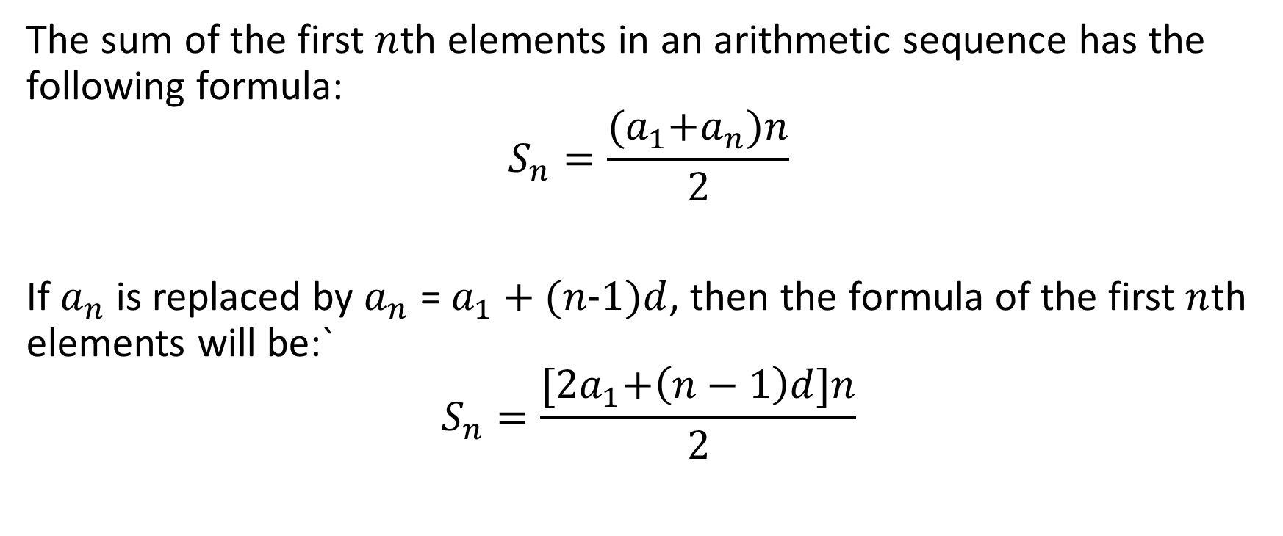
Sum of Arithmetic Sequence
The sum of the first $n$th elements in an arithmetic sequence has the following formula:
$$S_{n}=\frac{{(a}_{1}+a_{n})n}{2}$$
If $a_{n}$ is replaced by $a_{n}$ = $a_{1}+(n−1)d$, then the formula of the first $n$th elements will be:`
$$S_{n}=\frac{{[2a}_{1}+\left(n−1\right)d]n}{2}$$

Slide 19
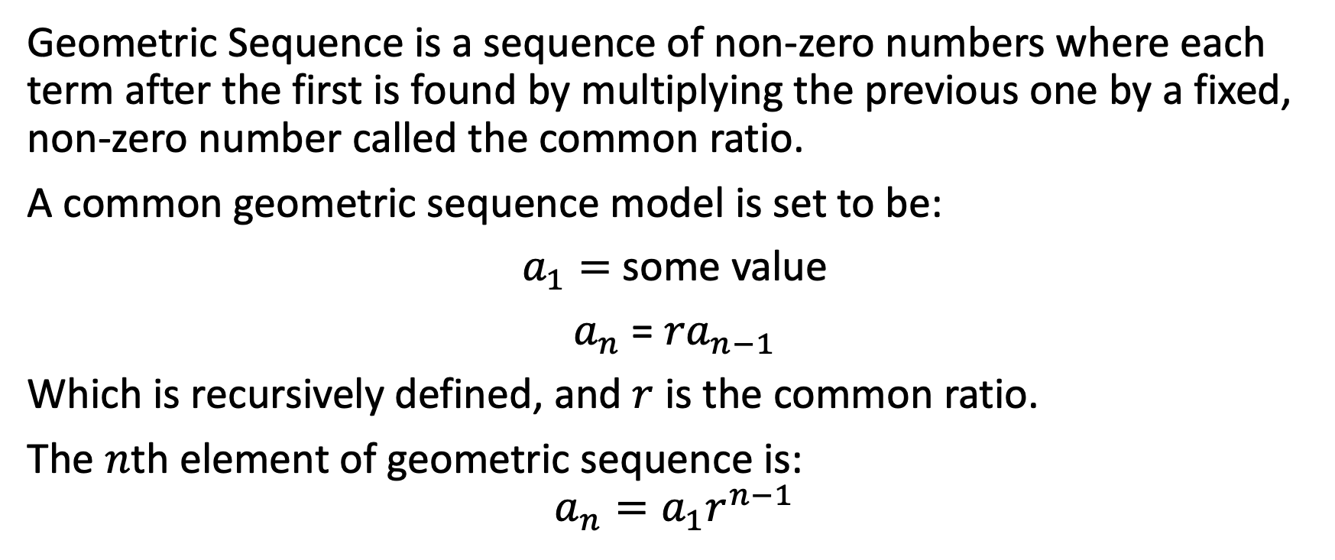
Geometric Sequence
Geometric Sequence is a sequence of non-zero numbers where each term after the first is found by multiplying the previous one by a fixed, non-zero number called the common ratio.
A common geometric sequence model is set to be:
$a_{1}=$ some value
$a_{n}$ = ${ra}_{n−1}$
Which is recursively defined, and $r$ is the common ratio.
The $n$th element of geometric sequence is:
$${a_{n}=a_{1}r}^{n−1}$$

Slide 20
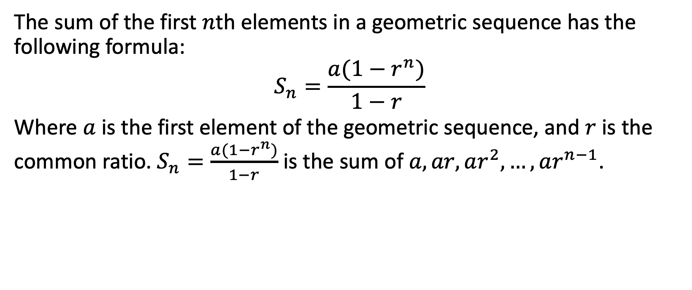
Sum of Geometric Sequence
The sum of the first $n$th elements in a geometric sequence has the following formula:
$$S_{n}=\frac{a(1−r^{n})}{1−r}$$
Where $a$ is the first element of the geometric sequence, and $r$ is the common ratio. $S_{n}=\frac{a(1−r^{n})}{1−r}$ is the sum of $a, ar, ar^{2}, …, ar^{n−1}$.

Slide 21
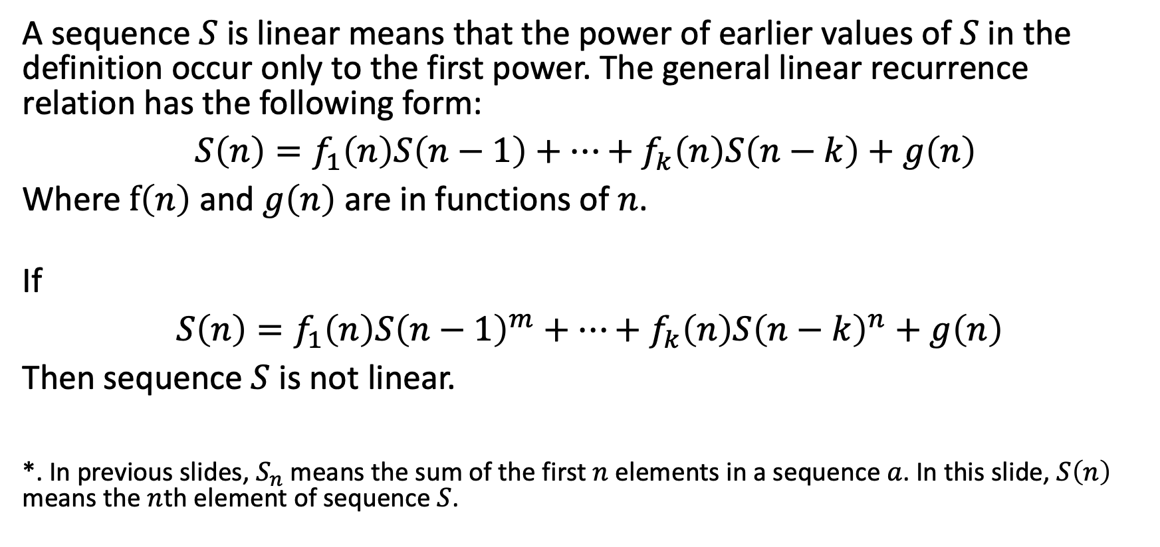
Linear First-Order Recurrence Relations
A sequence $S$ is linear means that the power of earlier values of $S$ in the definition occur only to the first power. The general linear recurrence relation has the following form:
$S\left(n\right)=f_{1}\left(n\right)S\left(n−1\right)+…+f_{k}\left(n\right)S\left(n−k\right)+g\left(n\right)$
Where $f\left(n\right)$ and $g\left(n\right)$ are in functions of $n$.
If
$S\left(n\right)=f_{1}\left(n\right){S\left(n−1\right)}^{m}+…+f_{k}\left(n\right){S\left(n−k\right)}^{n}+g\left(n\right)$
Then sequence $S$ is not linear.
*. In previous slides, $S_{n}$ means the sum of the first $n$ elements in a sequence $a$. In this slide, $S\left(n\right)$ means the $n$th element of sequence $S$.

Slide 22
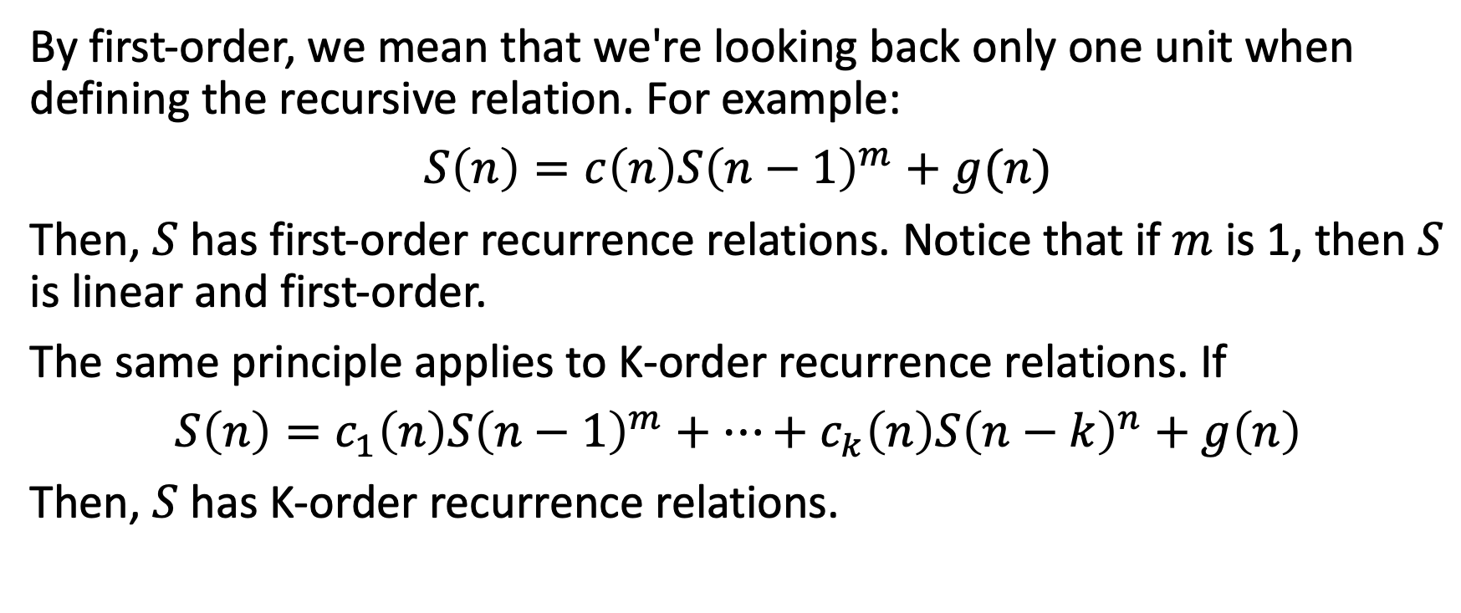
Linear First-Order Recurrence Relations
By first-order, we mean that we're looking back only one unit when defining the recursive relation. For example:
$S\left(n\right)=c\left(n\right){S\left(n−1\right)}^{m}+g(n)$
Then, $S$ has first-order recurrence relations. Notice that if $m$ is 1, then $S$ is linear and first-order.
The same principle applies to K-order recurrence relations. If
$S\left(n\right)=c_{1}\left(n\right){S\left(n−1\right)}^{m}+…+c_{k}\left(n\right){S\left(n−k\right)}^{n}+g\left(n\right)$
Then, $S$ has K-order recurrence relations.

Slide 23
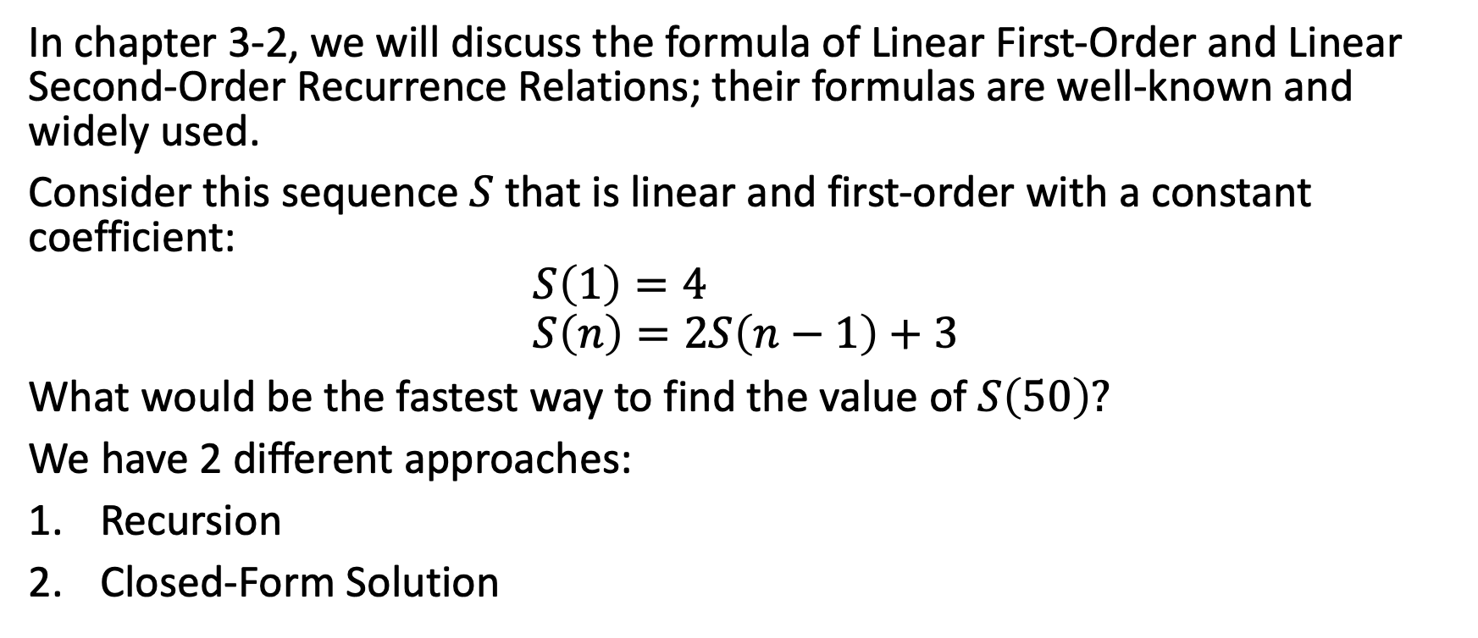
Linear First-Order Recurrence Relations
In chapter 3-2, we will discuss the formula of Linear First-Order and Linear Second-Order Recurrence Relations; their formulas are well-known and widely used.
Consider this sequence $S$ that is linear and first-order with a constant coefficient:
$$S\left(1\right)=4 \\ S\left(n\right)=2S\left(n−1\right)+3$$
What would be the fastest way to find the value of $S\left(50\right)?$
We have 2 different approaches:
Recursion
Closed-Form Solution

Slide 24


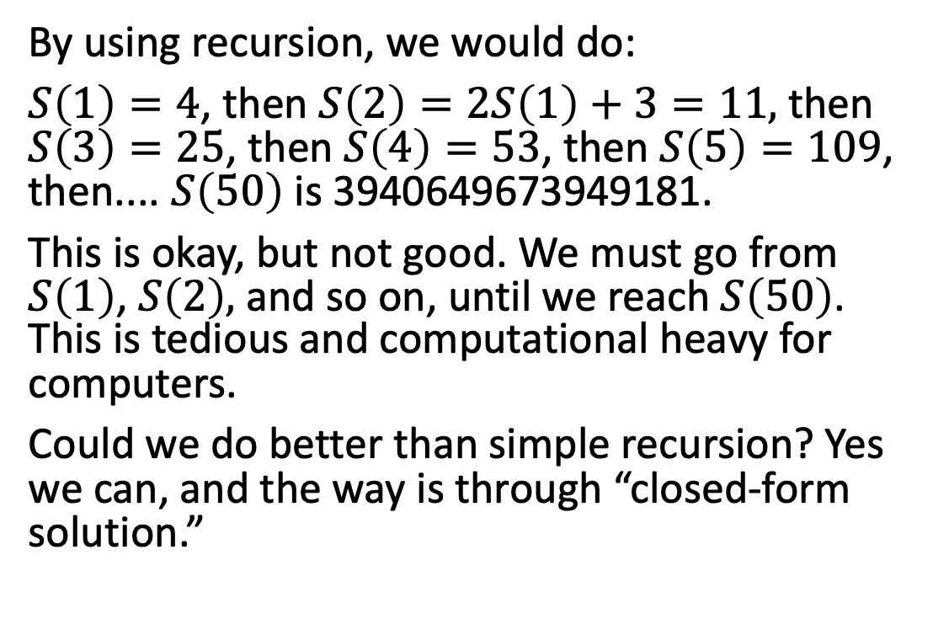
Find $S\left(50\right)$
By using recursion, we would do:
$S\left(1\right)=4$, then $S\left(2\right)=2S\left(1\right)+3=11,$then $S\left(3\right)=25$, then $S\left(4\right)=53$, then $S\left(5\right)=109$, then.... $S\left(50\right)$ is 3940649673949181.
This is okay, but not good. We must go from $S\left(1\right)$, $S\left(2\right),$ and so on, until we reach $S\left(50\right)$. This is tedious and computational heavy for computers.
Could we do better than simple recursion? Yes we can, and the way is through “closed-form solution.”

Slide 25
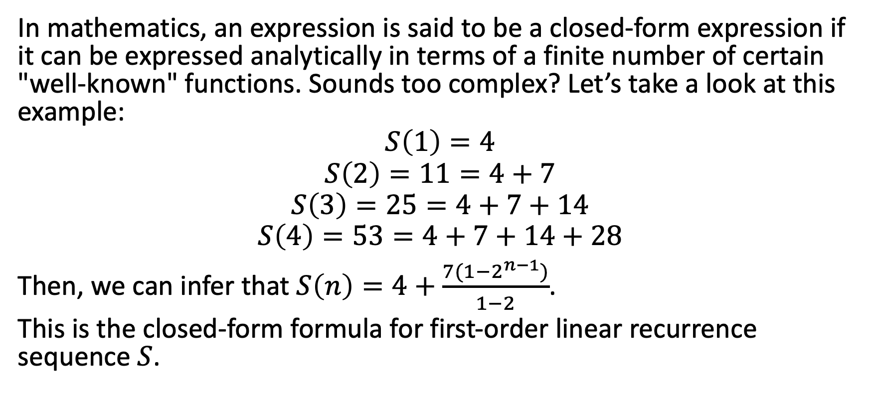
Closed-Form Solution
In mathematics, an expression is said to be a closed-form expression if it can be expressed analytically in terms of a finite number of certain "well-known" functions. Sounds too complex? Let’s take a look at this example:
$$S\left(1\right)=4$$
$$S\left(2\right)=11=4+7$$
$$S\left(3\right)=25=4+7+14$$
$$S\left(4\right)=53=4+7+14+28$$
Then, we can infer that $S\left(n\right)=4+\frac{7(1−2^{n−1})}{1−2}$.
This is the closed-form formula for first-order linear recurrence sequence $S$.

Slide 26

Coding Lesson
Try to verify that the closed-form solution and recusion algorithm will return the same result of $S\left(50\right)$. Also, time the codes so that we know which one takes more time.

Slide 27
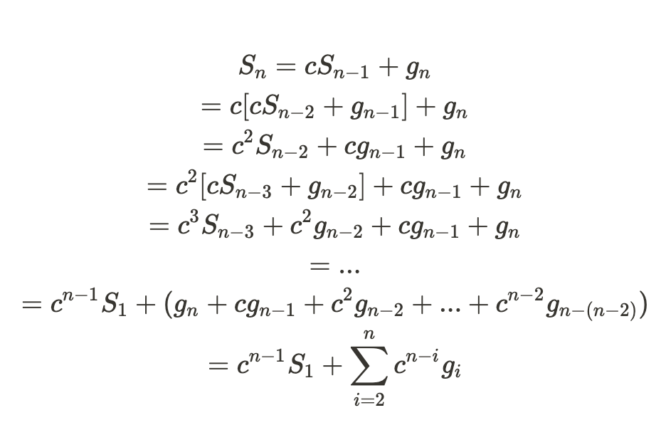
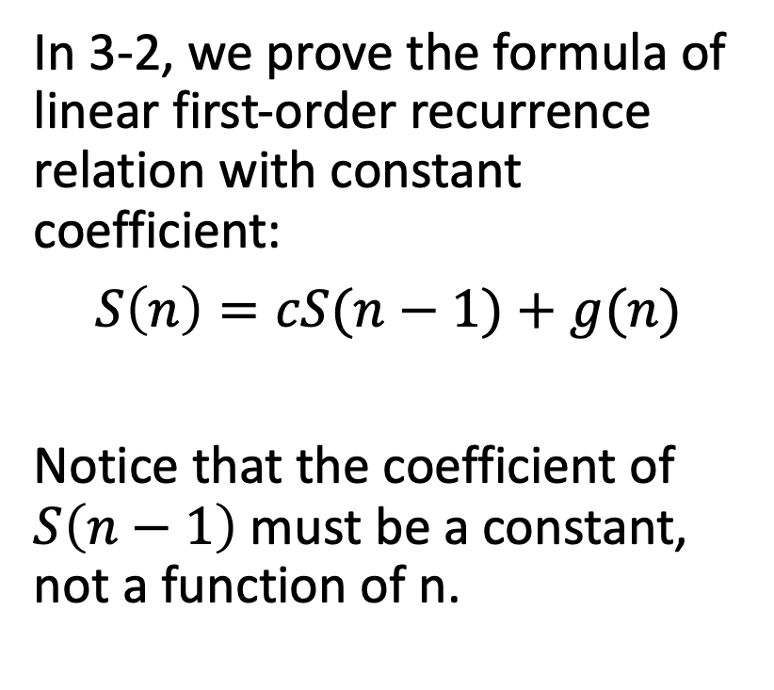
Formula Proof
In 3-2, we prove the formula of linear first-order recurrence relation with constant coefficient:
$S\left(n\right)=cS(n−1)+g(n)$
Notice that the coefficient of $S\left(n−1\right)$ must be a constant, not a function of n.

Slide 28

Example 3-2-1
Using the formula of linear first-order recurrence relation, find the closed-form solution of:
$$S\left(1\right)=4 \\ S\left(n\right)=2S\left(n−1\right)+3$$

Slide 29
Example 3-2-2
Consider the problem of reading data from a computer disk drive. The disk has multiple track, and computer has a read head that can read data in tracks. The following table shows the distance of destination track and source track.
Source/destina-tion | 1 | 2 | 3 | 4 | 5
1 | 0 | 1 | 2 | 3 | 4
2 | 1 | 0 | 1 | 2 | 3
3 | 2 | 1 | 0 | 1 | 2
4 | 3 | 2 | 1 | 0 | 1
5 | 4 | 3 | 2 | 1 | 0

Slide 30
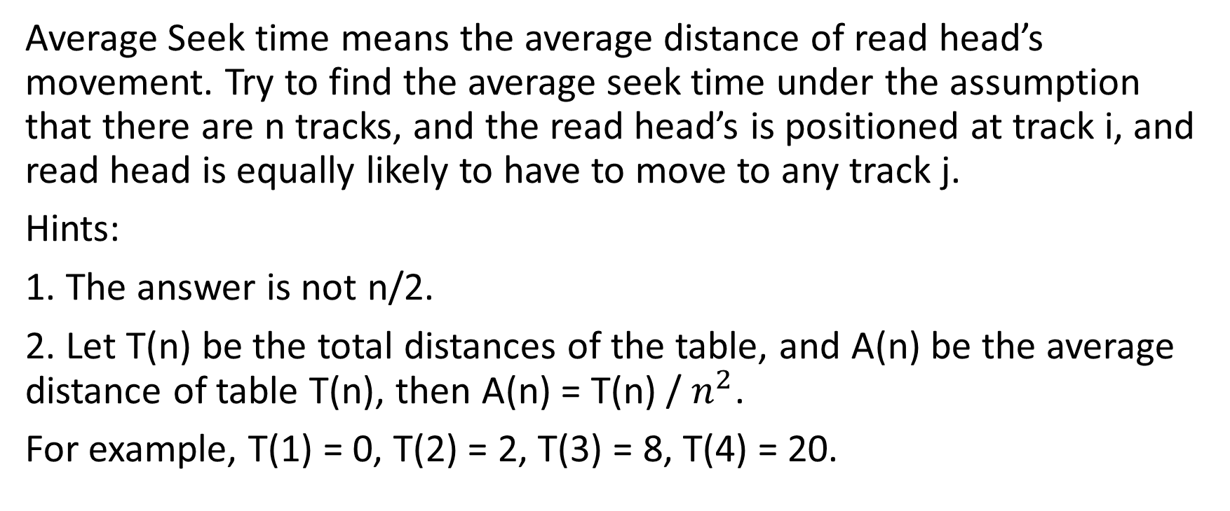
Example 3-2-2
Average Seek time means the average distance of read head’s movement. Try to find the average seek time under the assumption that there are n tracks, and the read head’s is positioned at track i, and read head is equally likely to have to move to any track j.
Hints:
1. The answer is not n/2.
2. Let T(n) be the total distances of the table, and A(n) be the average distance of table T(n), then A(n) = T(n) / $n^{2}$.
For example, T(1) = 0, T(2) = 2, T(3) = 8, T(4) = 20.

Slide 31
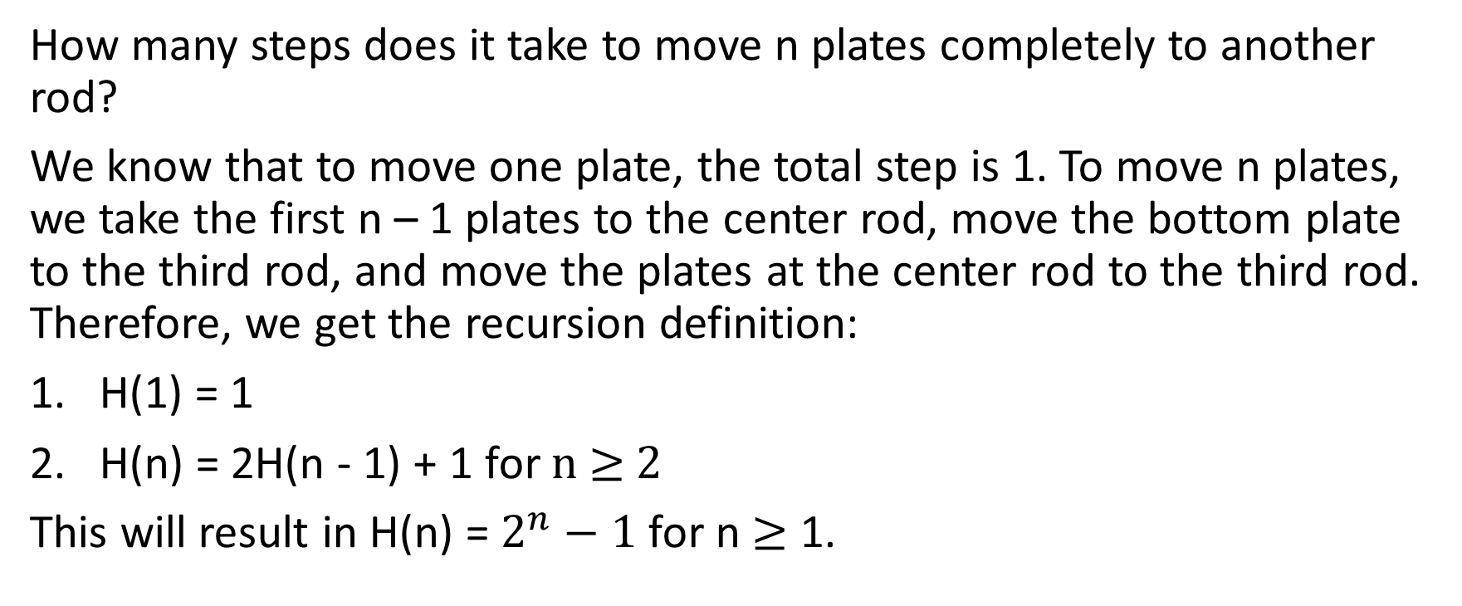
Hanoi Tower Analysis
How many steps does it take to move n plates completely to another rod?
We know that to move one plate, the total step is 1. To move n plates, we take the first n – 1 plates to the center rod, move the bottom plate to the third rod, and move the plates at the center rod to the third rod. Therefore, we get the recursion definition:
H(1) = 1
H(n) = 2H(n - 1) + 1 for n $≥$ 2
This will result in H(n) = $2^{n}−1$ for n $≥$ 1.

Slide 32

Linear Second-Order Recurrence Relations
A form of linear second-order recurrence with constant coefficients would be:
$$S\left(n\right)=c_{1}S\left(n−1\right)+c_{2}S(n−2)$$
The proof of the formula is kinda tricky. Therefore, it’s an optional lecture to learn how to find the formula.

Slide 33

Example 3-2-3
Supposed a linear second-order recurrence sequence is defined as:
$S\left(0\right)=3, S\left(1\right)=8$ $S\left(n\right)=3S\left(n−1\right) − 2S(n−2)$, for all n $≥$ 2
Find the closed-form solution of sequence $S$.

Slide 34
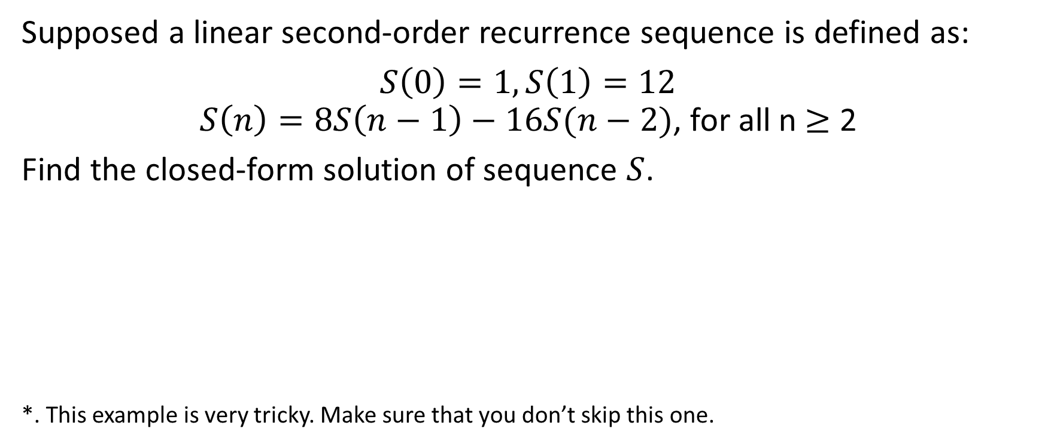
Example 3-2-4
Supposed a linear second-order recurrence sequence is defined as:
$S\left(0\right)=1, S\left(1\right)=12$ $S\left(n\right)=8S\left(n−1\right)−16S(n−2)$, for all n $≥$ 2
Find the closed-form solution of sequence $S$.
*. This example is very tricky. Make sure that you don’t skip this one.

Slide 35
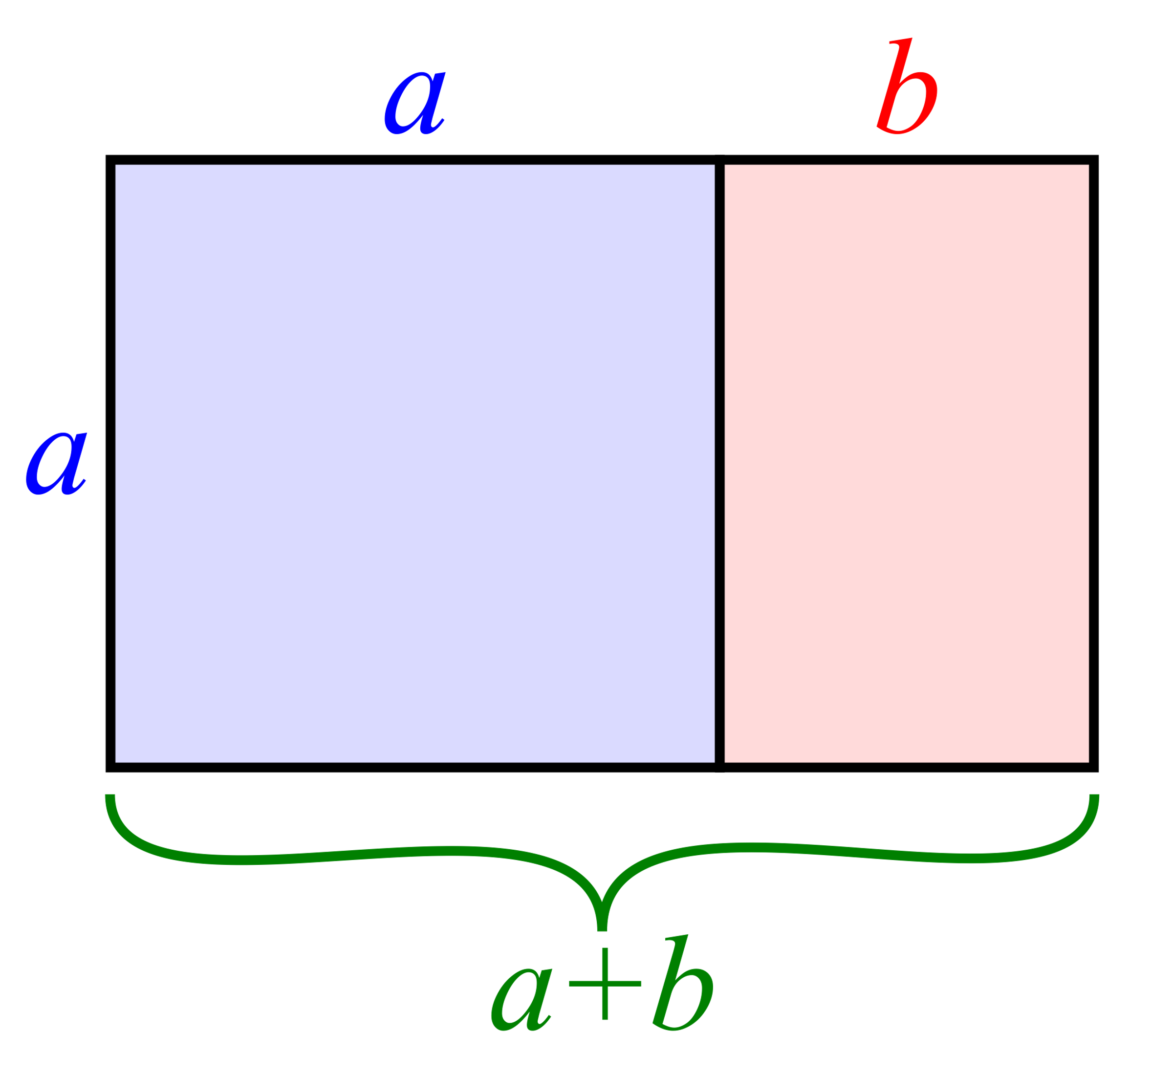
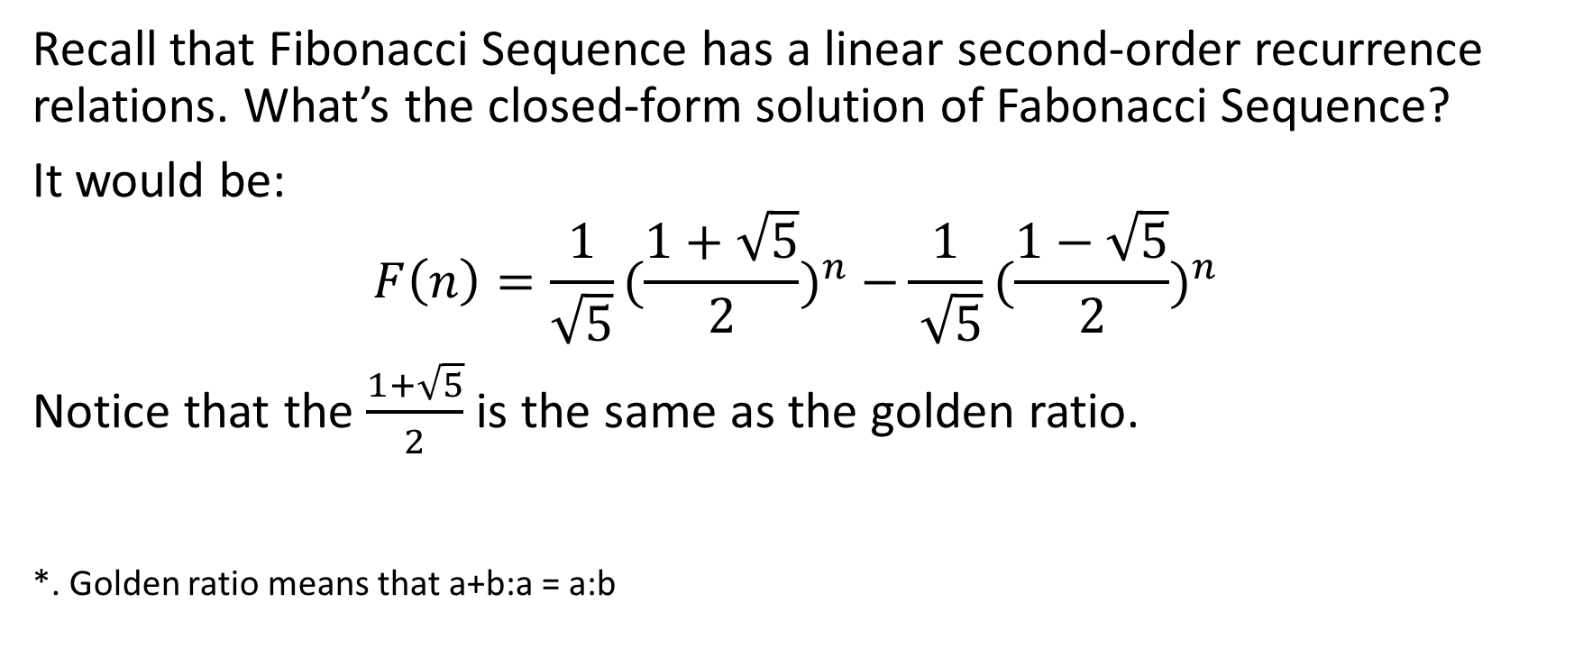
Fibonacci Sequence
Recall that Fibonacci Sequence has a linear second-order recurrence relations. What’s the closed-form solution of Fabonacci Sequence?
It would be:
$$F\left(n\right)=\frac{1}{\sqrt{5}}{(\frac{1+\sqrt{5}}{2})}^{n} −\frac{1}{ \sqrt{5}}{(\frac{1−\sqrt{5}}{2})}^{n}$$
Notice that the $\frac{1+\sqrt{5}}{2}$ is the same as the golden ratio. *. Golden ratio means that a+b:a = a:b

Slide 36
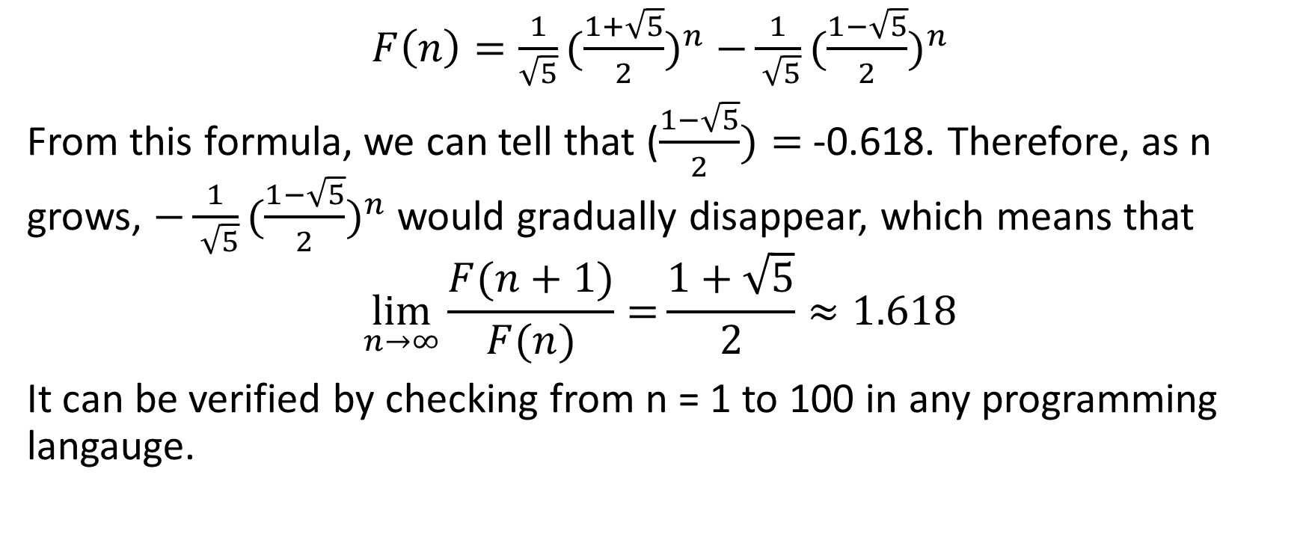
Fibonacci Sequence (Calculus Required)
$F\left(n\right)=\frac{1}{\sqrt{5}}{(\frac{1+\sqrt{5}}{2})}^{n} −\frac{1}{ \sqrt{5}}{(\frac{1−\sqrt{5}}{2})}^{n}$
From this formula, we can tell that ($\frac{1−\sqrt{5}}{2})=$ -0.618. Therefore, as n grows, $−\frac{1}{ \sqrt{5}}{(\frac{1−\sqrt{5}}{2})}^{n}$ would gradually disappear, which means that
$$\lim_{n→∞}{\frac{F(n+1)}{F(n)}=}\frac{1+\sqrt{5}}{2}≈1.618$$
It can be verified by checking from n = 1 to 100 in any programming langauge.

Slide 37

3-3 Analysis of Algorithms

Slide 38
The General Idea
We have seen that, from the examples of recursion and closed-form formula, many different algorithms can complete the same task; however, some of them are faster than others.
When analyzing algorithms, we would like to consider a question – what’s a good algorithm? Well, in general, an algorithm should be:
As fast as possible. No one likes to wait.
As compact as possible. We don’t want it to take too much memory.
Therefore, when analyzing an algorithm, we would like to measure the “time complexity” and “space complexity.”

Slide 39
Sequential Search and Binary Search
In algorithm and data structure, we will spend more time learning the details of time complexity measurement. Now, let’s learn 2 simple algorithms that complete the same task, but have different time complexity.
Supposed we have a sorted array, [11, 15, 23, 45, 69, 193, 199, 208, 303]. What is the fastest way to find the index position of number 199?
The first and simplest approach is to search from 11, then 15, then 23, until we find 199 at index 6. This is called “sequential search.”

Slide 40
Sequential Search and Binary Search
[11, 15, 23, 45, 69, 193, 199, 208, 303]
A even faster way is through binary search. Since this array is sorted, we can find the middle point of this array, which is index number 4; 69 is the middle point. Since 199 is bigger than 69, we know the index of 199 must be larger than 4. Then, from index 4 to 8, the middle point is 199 at index number 6. We found it!!
Binary search is like the playing ”ultimate keyword”, which we guess the keyword from range 1 to 100. The fastest way to get the keyword is by cutting the range into half.
*. Is there a even faster way to get the index of 199? There is, but we would learn about it in algorithm and data structure course.

